Slide 1

Zephyr Workshop – Threads & Workqueues
An in-depth exploration of Zephyr's threading model and workqueue system for efficient embedded application development

Slide 2
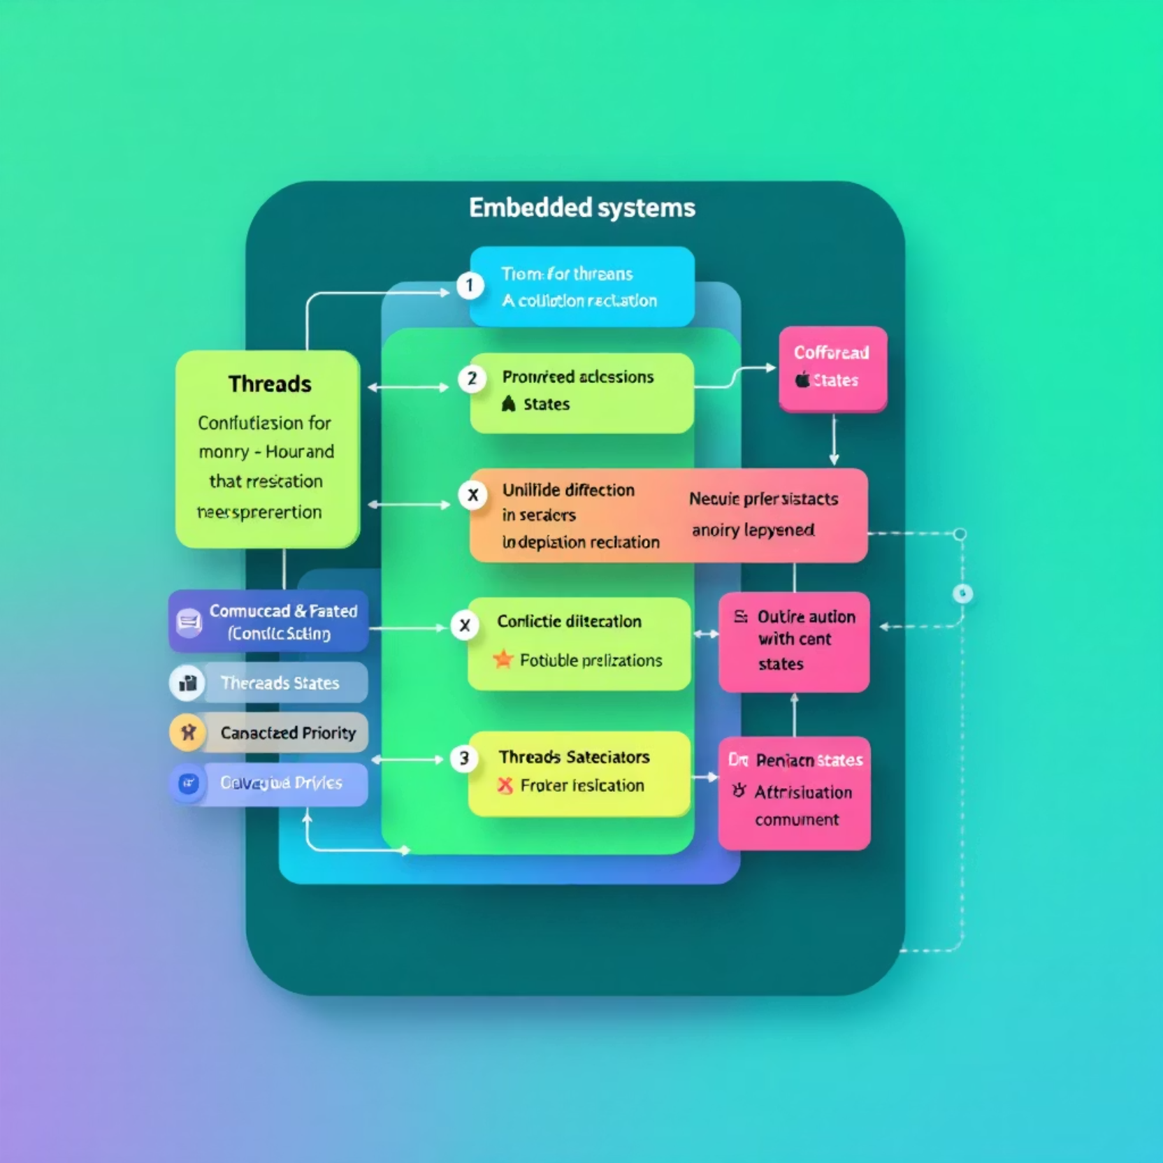
What is a Thread in Zephyr?
Basic unit of execution in Zephyr
Each thread has: stack, priority, entry point
Can be preemptive or cooperative
Used for independent, long-running tasks
Threads are ideal for independent, long-running tasks that may block or require significant processing time without affecting system responsiveness.

Slide 3




Thread API Concepts
Creation
Definition
k_thread_create()
K_THREAD_DEFINE()
Runtime thread creation with dynamic allocation. Thread parameters include stack pointer, entry function, and priority.
Static thread definition at compile time. Optimizes memory usage and startup performance.
Control
Scheduling
Thread priority determines execution order. Higher priority threads preempt lower priority ones unless cooperative scheduling is used.
k_sleep()
Pause thread execution for a specified duration. The scheduler will run other threads during this time.

Slide 4
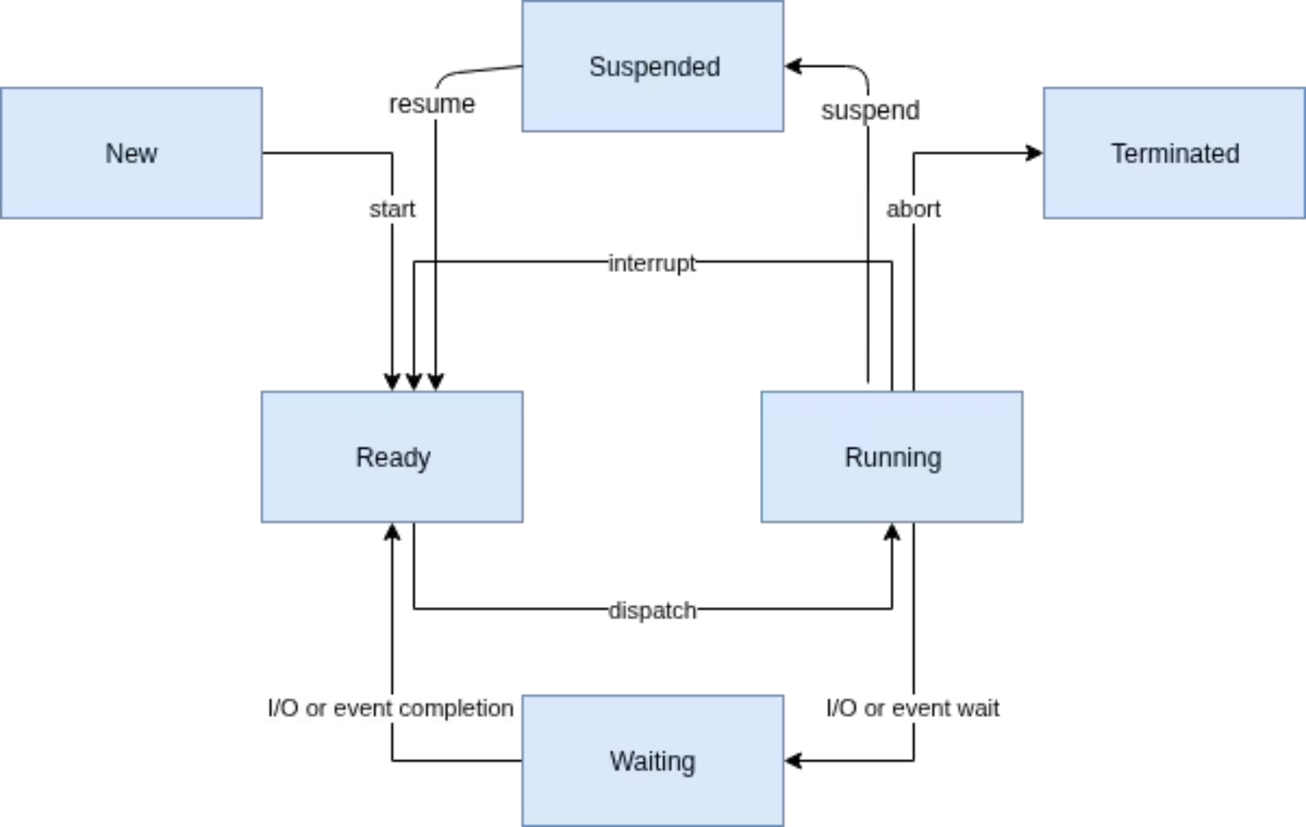
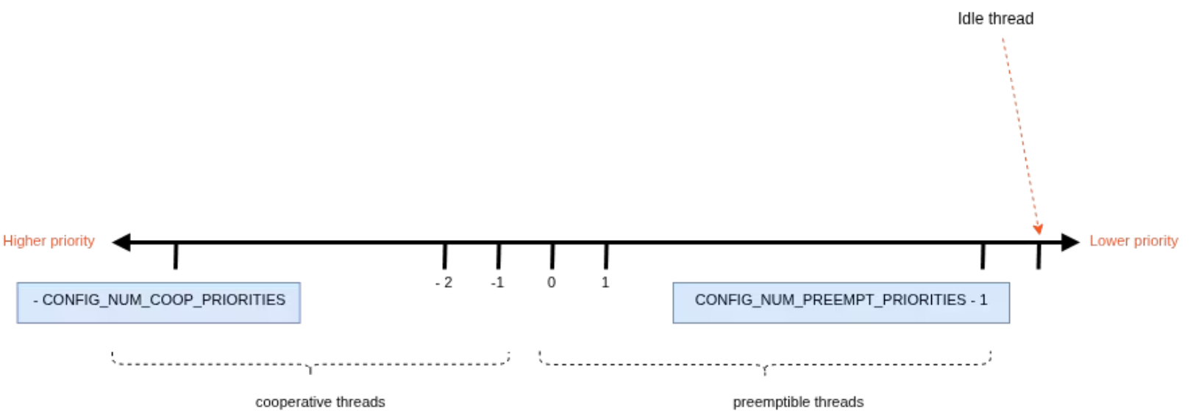
Thread States and Transitions
Thread State Diagram
Thread Execution Timeline
Zephyr's preemptive scheduler ensures high-priority threads receive immediate processor time, while cooperative threads voluntarily yield execution.
Thread states include: Ready, Running, Pending, and Suspended. Transitions between states are managed by the scheduler based on priority and system events.

Slide 5
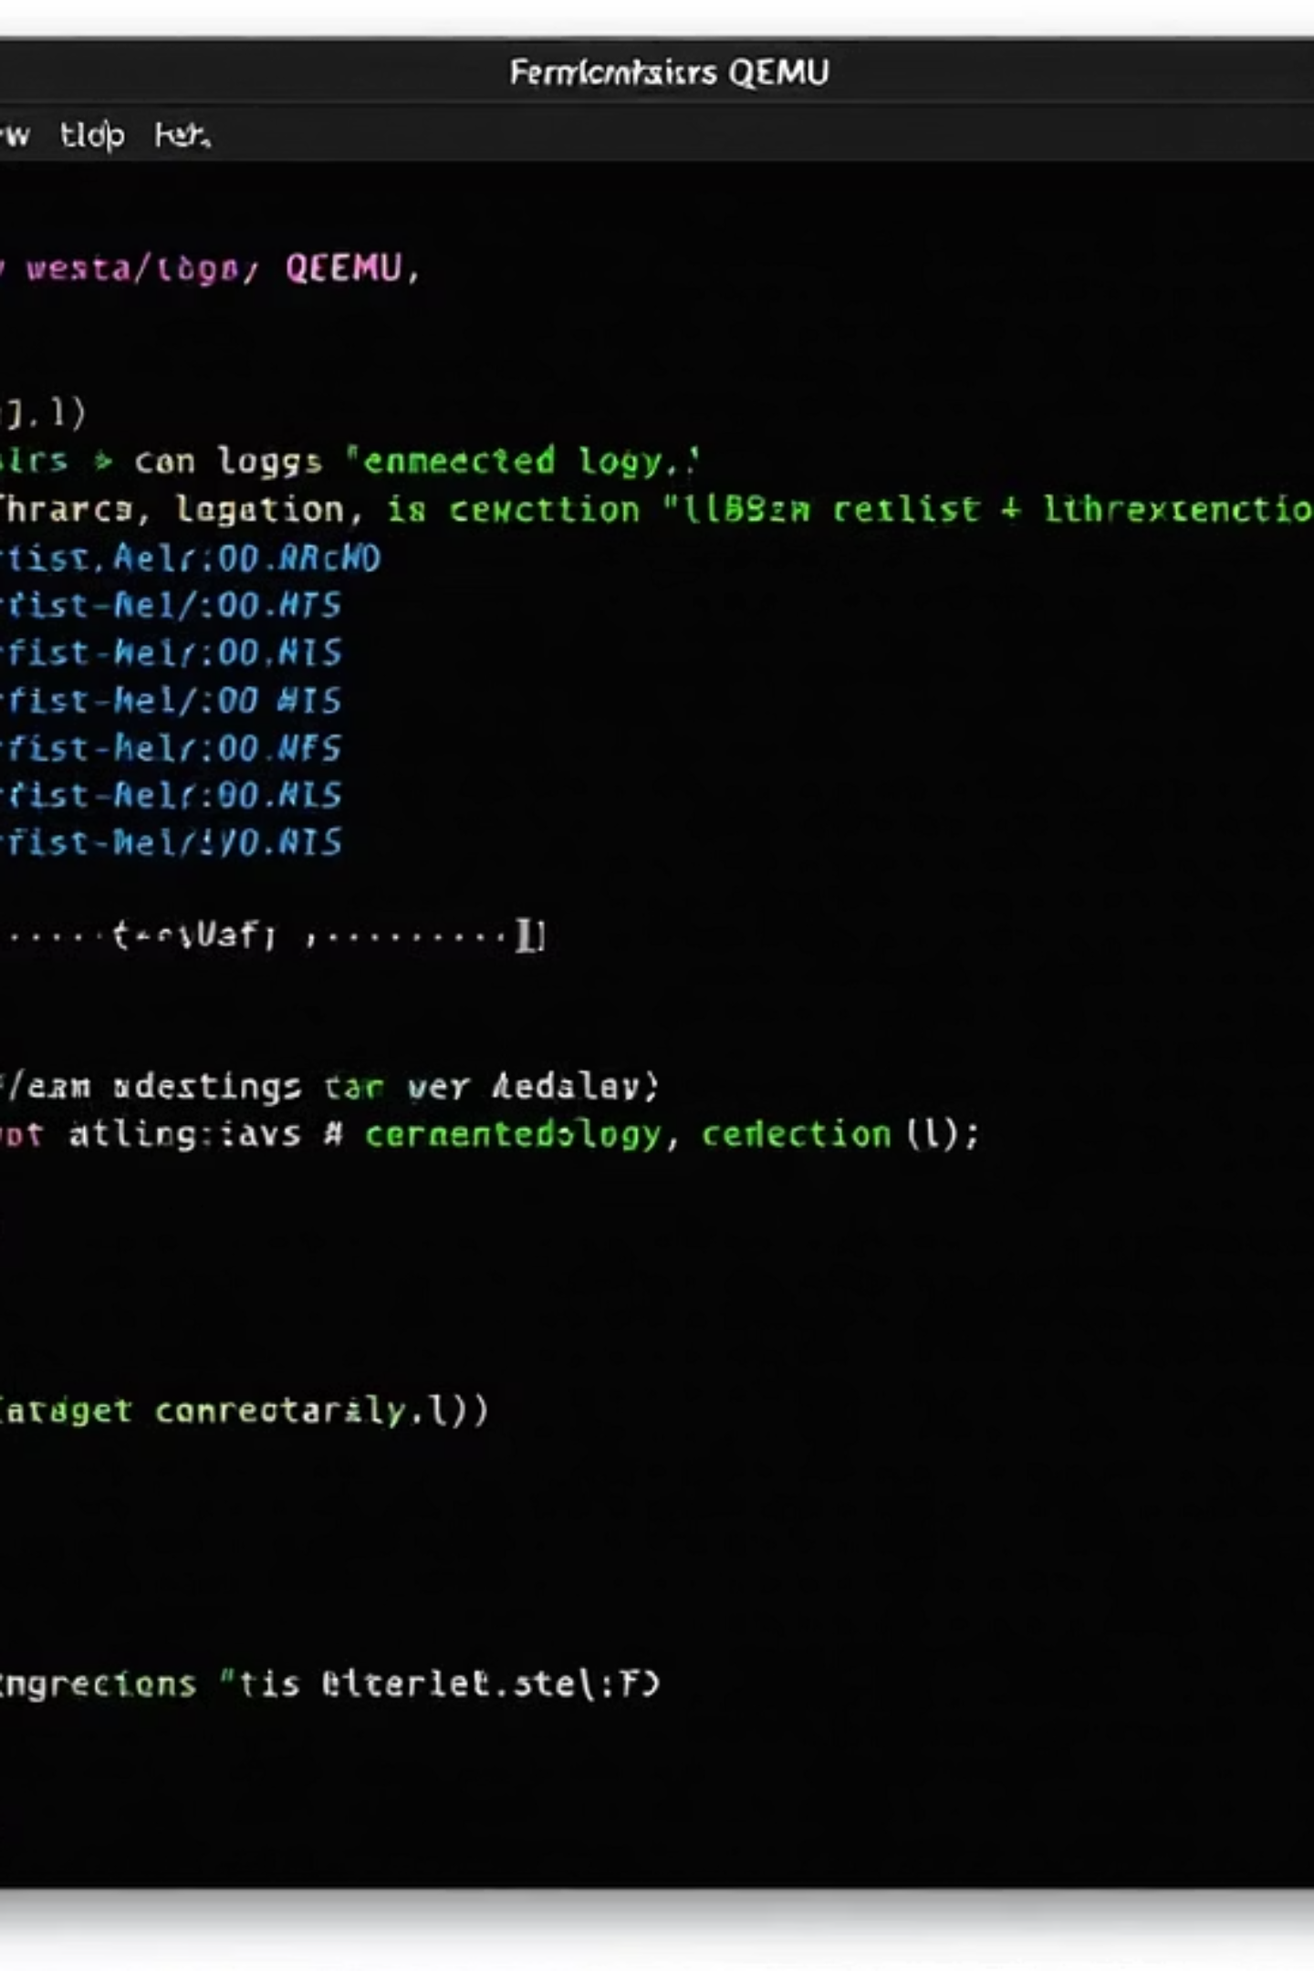
Basic Synchronization Demo
Running the Demo
west build -b qemu_cortex_m0 samples/synchronization
west build -t run
This demo runs on QEMU directly on your development machine, eliminating the need for physical hardware during initial learning.

Slide 6








What is a Workqueue?
Kernel Object
Deferred Execution
A workqueue is a kernel object that uses a dedicated thread to process work items in a FIFO (First In, First Out) manner.
Provides a mechanism for scheduling small tasks to run later, often from interrupt context.
Efficient
Lightweight
Avoids context switching overhead by batching multiple small tasks into a single thread execution context.
Uses significantly less resources than creating separate threads for small, periodic tasks.
Zephyr provides a system workqueue by default, but custom workqueues can be created with different priorities and stack sizes for specialized needs.

Slide 7
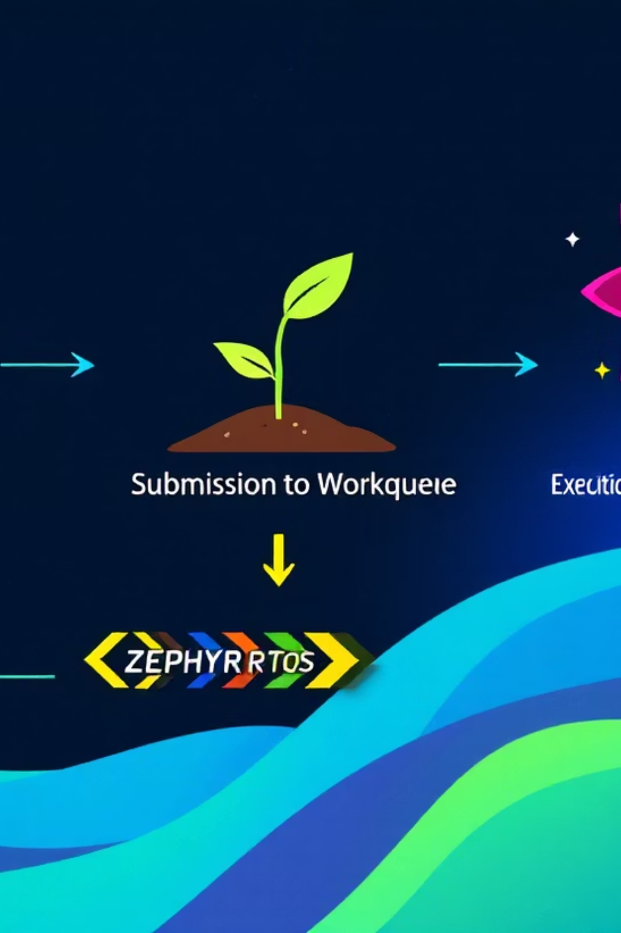
Workqueue API Concepts
Work Item Types
Core Functions
struct k_work: Basic work item for immediate or one-time deferred execution
k_work_init(&work,handler_function);
k_work_submit(&work);
k_work_schedule(&dwork, K_MSEC(100));
struct k_work_delayable: Enhanced work item that can be scheduled to run after a specified time period
The handler function signature must be:
Both types execute their handler functions in the context of the workqueue thread.
void handler(struct k_work *work);

Slide 8
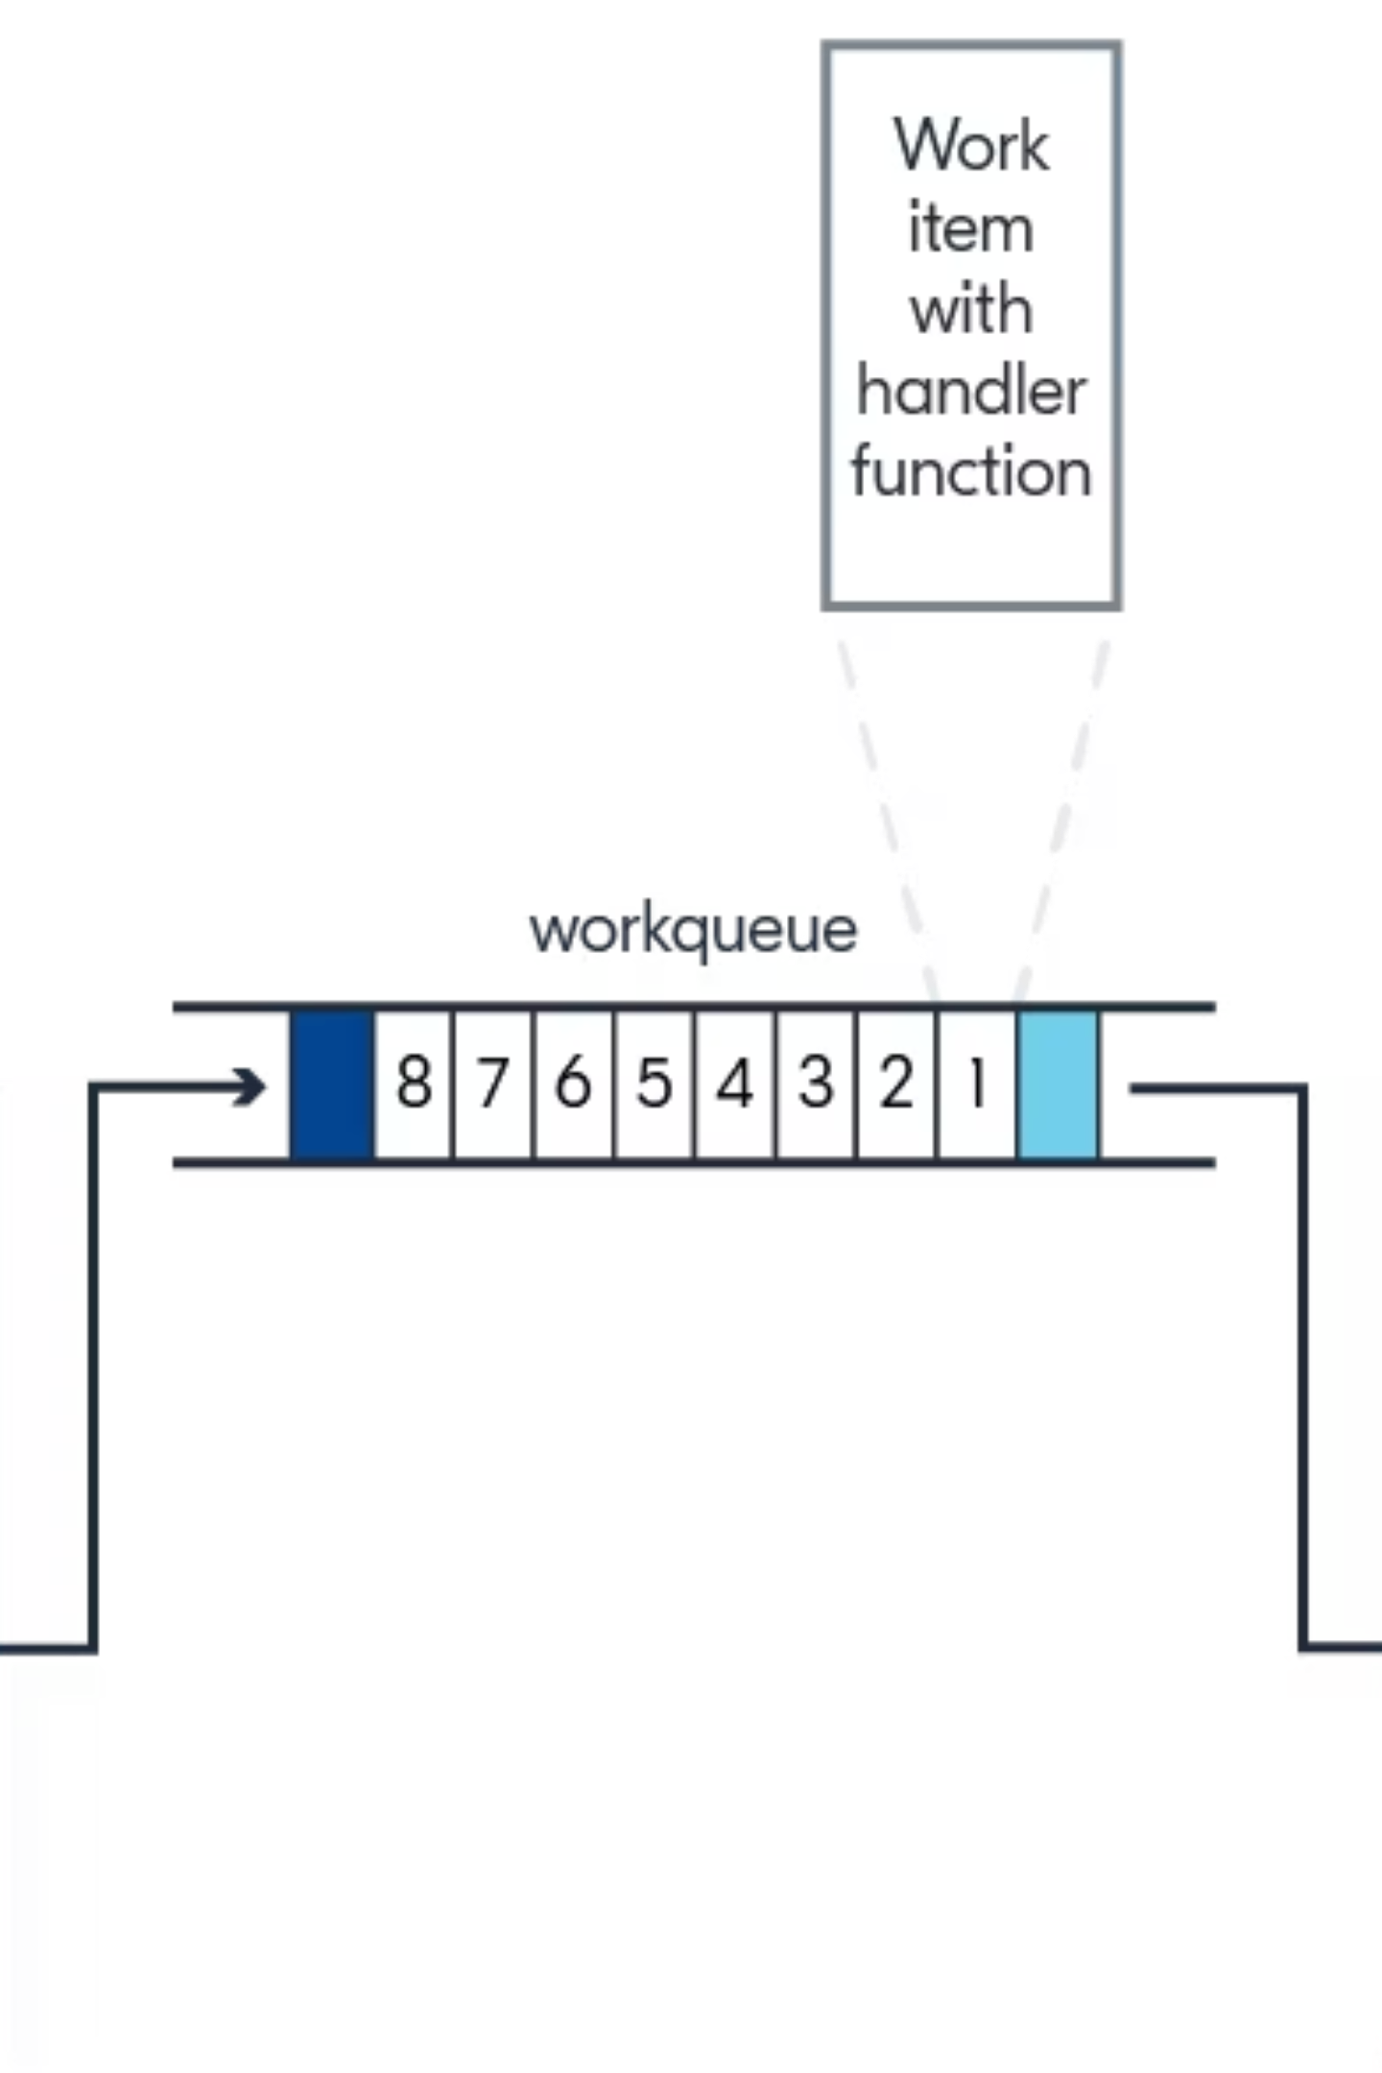
Workqueue Implementation
The diagram illustrates how work items flow through the system. When submitted, they enter a FIFO queue and are processed sequentially by the workqueue thread. Delayable work items are managed by a timing wheel that efficiently tracks when each item should be executed.
The system workqueue runs at priority 0 (highest) by default, making it suitable for time-sensitive operations that must execute promptly but are too short to justify a dedicated thread.

Slide 9
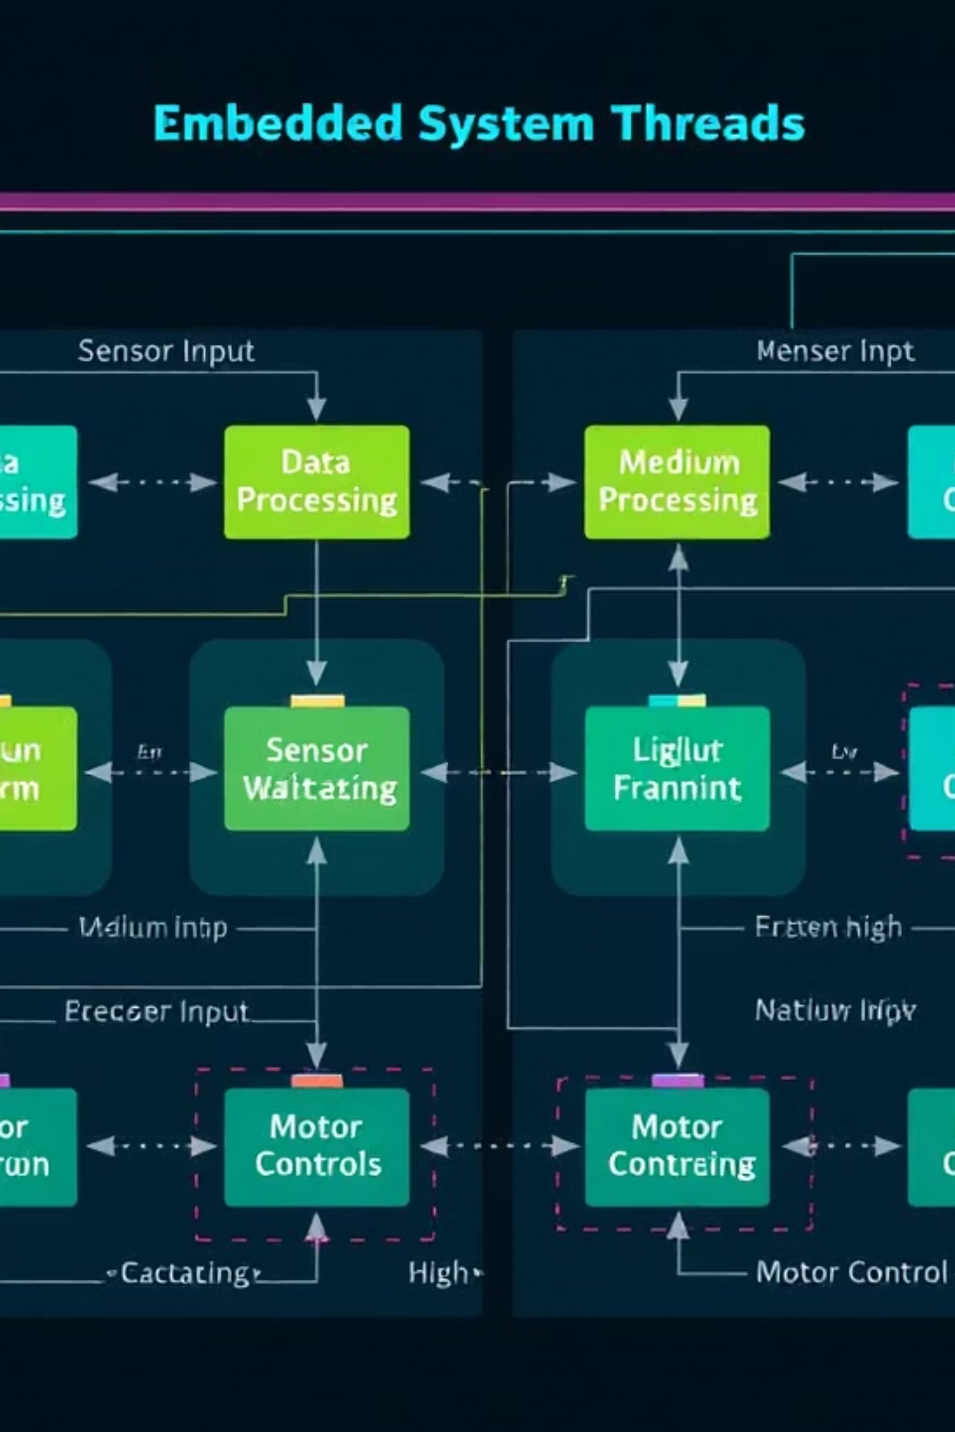
When to Use Threads
Long-running background operations
Independent state machines
Polling or waiting logic

Slide 10
When to Use Workqueues
Short, Non-blocking Tasks
Example Implementation
Brief operations that complete quickly and don't block. Examples include updating status indicators or triggering state changes.
/* Define work item */K_WORK_DEFINE(process_work, process_handler);
/* In ISR */void sensor_isr(void) {
/* Read sensor data */ read_sensor_data();
/* Defer processing to workqueue */k_work_submit(&process_work);
}
/* Work handler */void process_handler(struct k_work *work) {
/* Process data outside ISR context */ analyze_sensor_data(); update_display();
}
Interrupt Deferral
Moving processing out of interrupt context to prevent extended ISR execution. Perfect for sensor data processing, message handling, or flash operations.
Periodic Maintenance
Regularly scheduled lightweight tasks like watchdog refreshing, connection keepalives, or system health checks.

Slide 11
Exercise WorkQueue
Use Workqueue to blink the led every 2 seconds
Extra: stop the led blinking if button was pressed, resume the blinking on another press

